Slide 1
Quicksort With Different Partition Strategies
By Max Millar, JoanMarie Leone, and John Perez

Slide 2
Purpose of Quicksort Partitions
Quicksort is a O(nlgn) sorting algorithm that involves partitioning at each step
A partition is a procedure which separates an input array into two sections based on a pivot
A section containing all elements less than the pivot
A section containing all elements greater than the pivot
We will be comparing the runtime efficiency of four different partition strategies

Slide 3
QUICKSORT PSEUDOCODE
QUICKSORT(B, q, s)
1 if q < s
2 r = PARTITION(B, q, s)
3 QUICKSORT(B, q, r - 1)
4 QUICKSORT(B, r + 1, s)

Slide 4
Quicksort Partitions
HOARES(B,q,s)
1 y = B[q]
2 j = q - 1
3 k = s + 1
4 while TRUE
5 repeat
6 k = k - 1
7 until B[k] <= y
8 repeat
9 j = j + 1
10 until B[j] >= y
11 if j < k
12 exchange B[j] with B[k]
13 else return k
LOMUTO(B,q,s)
1 y = B[s]
2 j = q - 1
3 for k = q to s - 1
4 if B[k] <= y
5 j = j + 1
6 exchange B[j] with B[k]
7 exchange B[j + 1] with B[s]
8 return j + 1
RANDOM-HOARES(B, q, s)
1 j = RANDOM(q,s)
2 exchange B[q] with B[j]
3 return HOARES(B, q, s)
RANDOM-LOMUTO(B, q, s)
1 j = RANDOM(q,s)
2 exchange B[s] with B[j]
3 return LOMUTO(B, q, s)

Slide 5
Quicksort Analysis
Worst case partition: Each partition results in one empty subarray and one subarray with the remaining elements
Best case partition: Each partition contains n/2 elements, depth of tree O(lgn)
Cost of partitioning: O(n)
Worst case runtime of Quicksort: O(n^2)
Average case runtime of Quicksort: O(nlgn)

Slide 6
Our Problem
What is the overall the most efficient quicksort partition strategy?
Partitions being tested…
Lomuto Partitioning
Hoare Partitioning
Randomized Partitioning with Lomuto
Randomized Partitioning with Hoare

Slide 7
Experimental Plan
Various datasets are being sorted by quicksort by each of the four partitions
Datasets of size 10 to 100000
Randomized, Sorted, and Inversely Sorted of each dataset
Metrics for partition comparisons:
Time taken for quicksort to complete
Number of swaps done by quicksort

Slide 8
Our Implementation
Code written in C++
Used int vectors for number storage
Global int variables for counting numbers of swaps

Slide 9

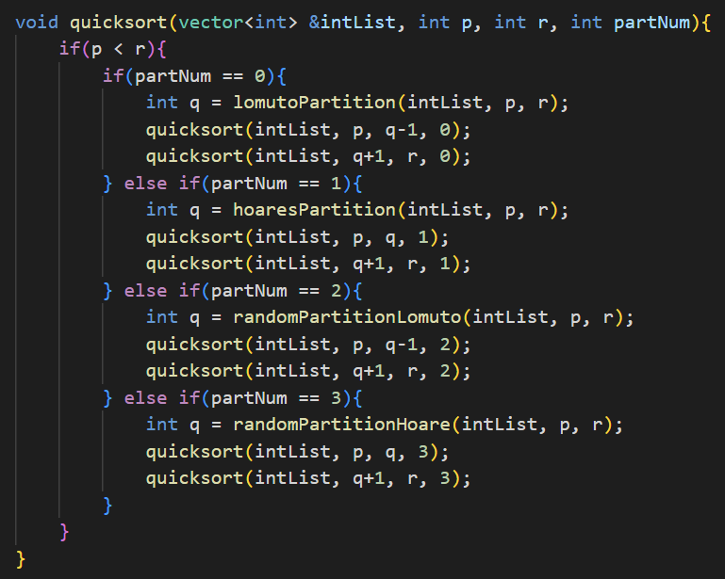

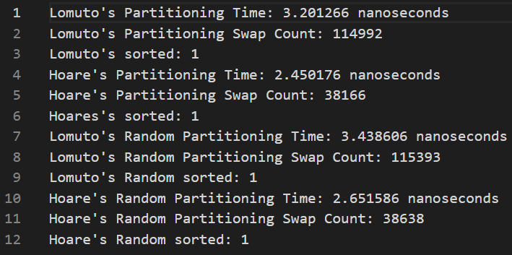
Demo

Slide 10
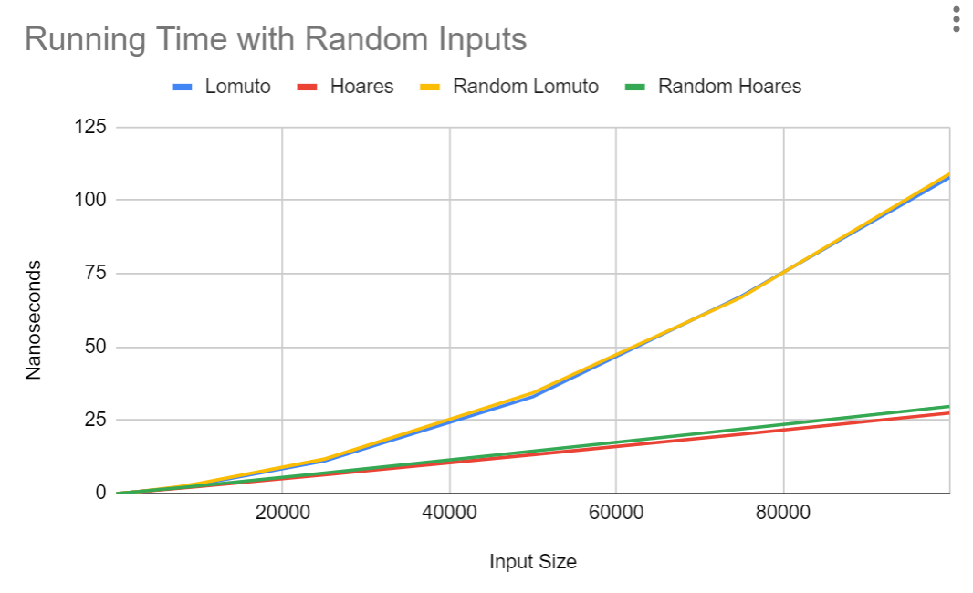
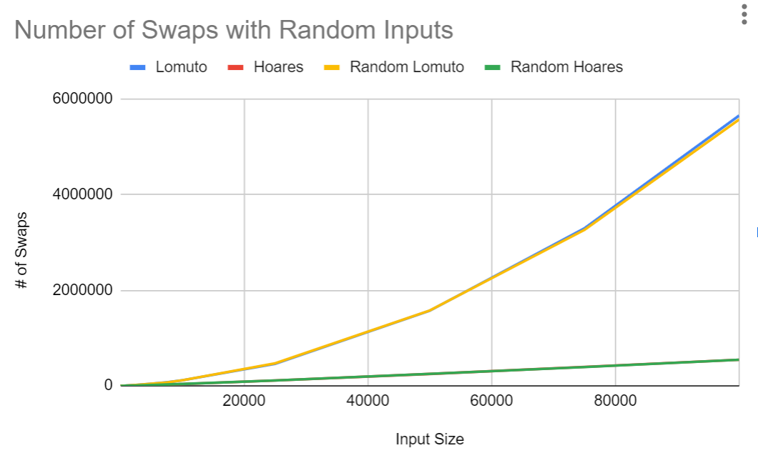
Results: Random Inputs
951204

Slide 11
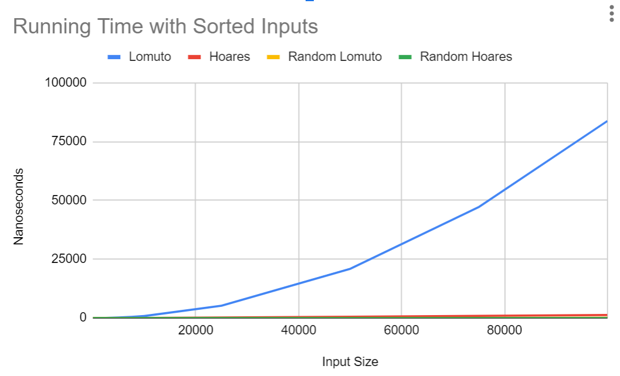
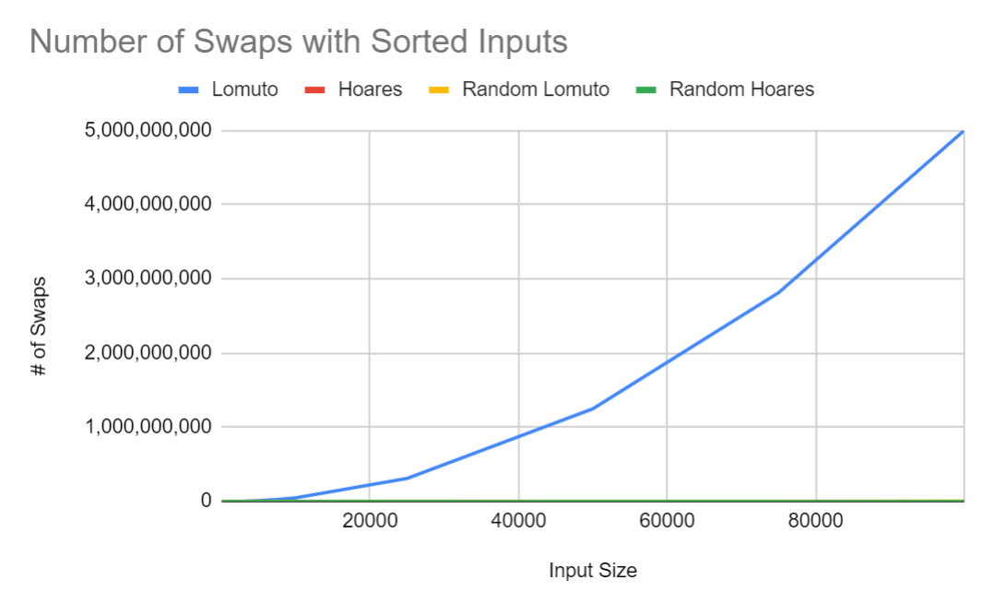
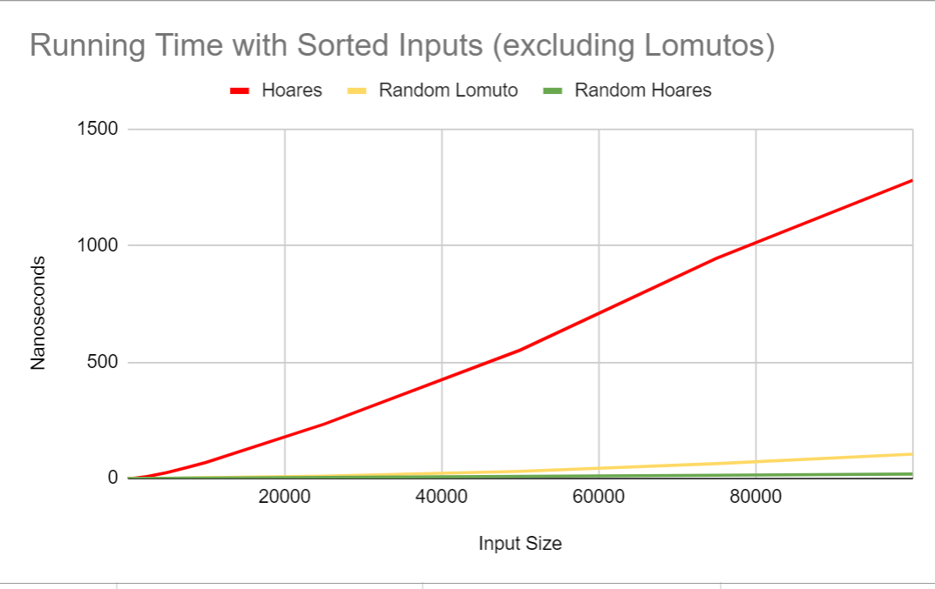
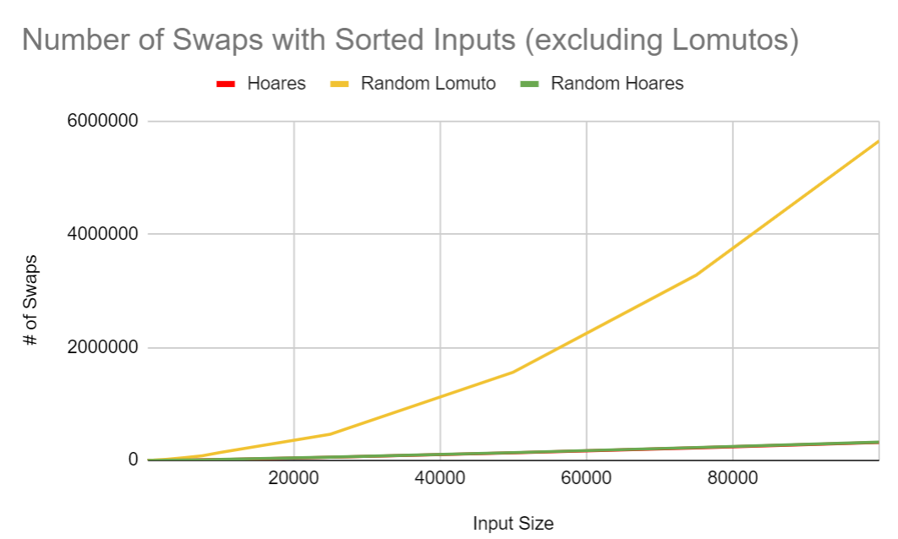
Results: Sorted Inputs

Slide 12
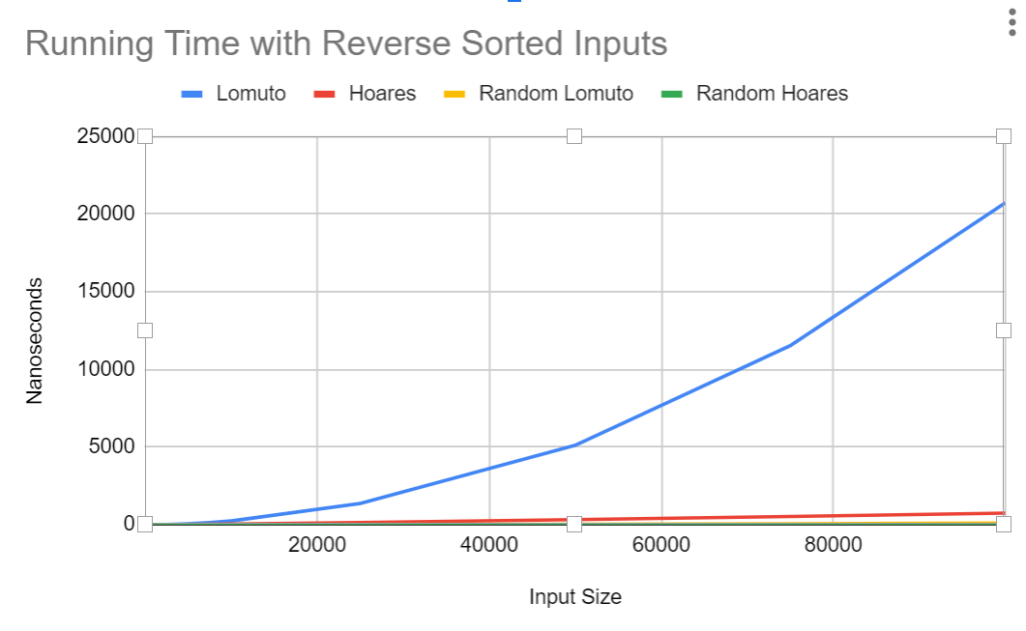
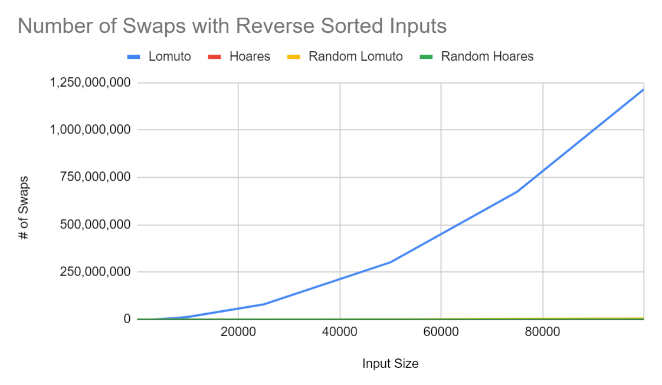
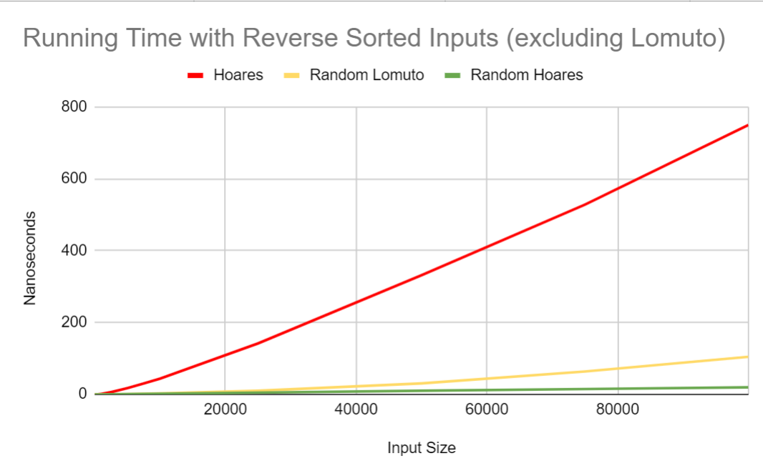
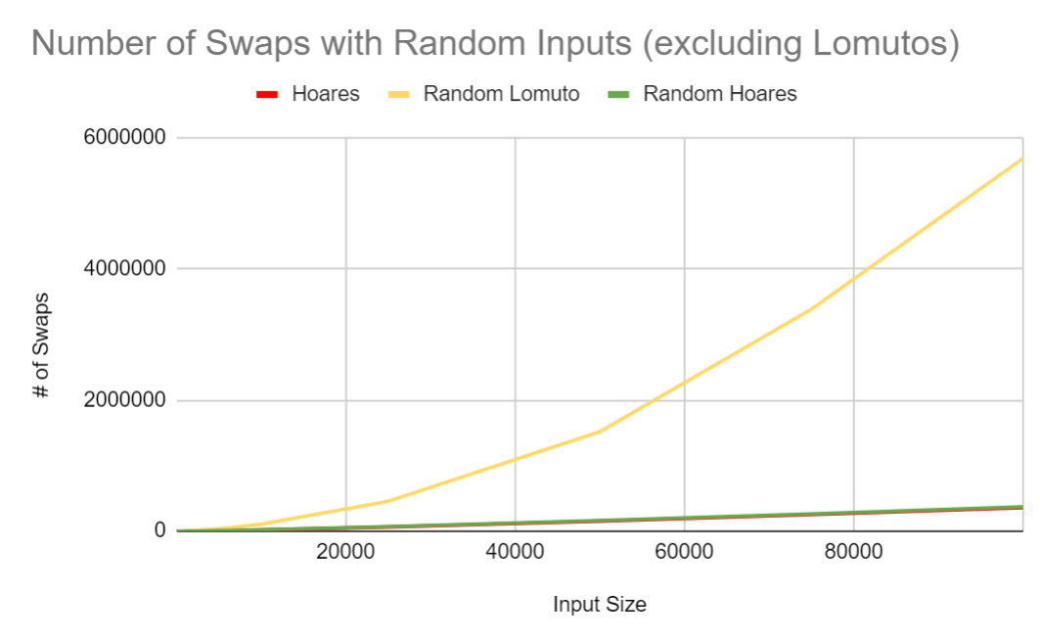
Results: Reverse Sorted Inputs

Slide 13
Limitations and Future Research
Range of numbers used in input files
Slightly sorted/reverse sorted input files
Use a very large dataset that requires days to test
Test against other sorting algorithms

Slide 14
Conclusion
Hoare’s and random Hoare’s outperformed Lomuto’s and random Lomuto’s with random inputs
Larger constant hidden factors in Lomutos algorithm
Random partitions outperformed regular partitions in time complexity on the sorted inputs and reverse sorted inputs
Hoare's performed slightly worse despite having less swaps than lomuto’s
Lomuto’s performed substantially worse
Random Lomuto’s most consistent across all inputs
Random Hoare’s most efficient running time overall

